Slide 1

Monthly Financial Report- As of January 31, 2025
City of Martinsville

Slide 2
GENERAL FUND SUMMARY as of January 31, 2025 Target Budget Use-58.3%
CATEGORIES | FYTD 2024-25 Actual | Encumbrances | Revised Budget | CY % of Budget Used | FY 2023-24 Actual | LY % of Budget Used
Revenue
39 - REAL PROP TAXES | 4,543,249 | - | 7,860,482 | 57.8% | 4,256,085 | 55.7%
40 - PERSNL/BUS PROP TAX | 2,823,552 | - | 2,744,500 | 102.9% | 2,604,580 | 103.2%
41 - SALES & OTHER TAXES | 4,639,928 | - | 8,618,071 | 53.8% | 4,462,230 | 55.4%
42 - FRANCHISE FEES | 31,925 | - | 1,577,624 | 2.0% | 275,058 | 49.8%
43 - PERMITS & LICENSES | 409,571 | - | 2,280,300 | 18.0% | 120,085 | 5.7%
44 - FINES/COURT/FORFEIT | 114,923 | - | 128,750 | 89.3% | 61,820 | 47.3%
45 - REV-USE MONEY/PROP | 442,512 | - | 1,752,157 | 25.3% | 852,344 | 51.7%
46 - CHARGES FOR SERVICES | 575,524 | - | 841,350 | 68.4% | 462,038 | 52.9%
47 - RECOVERD & OTHR/DEBT | 405,876 | - | 542,425 | 74.8% | 476,584 | 53.9%
48 - INTERGOV REVENUE | 4,398,142 | - | 7,006,569 | 62.8% | 6,241,651 | 56.3%
49 - TRANS FROM OTHR FUND | 3,075,550 | - | 4,501,100 | 68.3% | 1,475,022 | 57.5%
90 - BUDGETARY OFFSET ACC | - | - | 243,102 | 0.0% | - | 0.0%
Revenue Total | 21,460,751 | - | 38,096,430 | 56.3% | 21,287,498 | 52.4%
Expense
50 - SALARY AND BENEFITS | (11,335,610) | - | (20,461,581) | 55.4% | (11,276,708) | 51.8%
51 - INTERGOV EXPENSES | (794,328) | (22,996) | (2,177,435) | 37.3% | (913,984) | 45.0%
52 - SUPPLIES & MATERIALS | (815,053) | (49,023) | (1,273,049) | 65.7% | (736,483) | 43.6%
53 - PROF. SERVICES | (324,414) | (27,528) | (222,814) | 157.0% | (164,007) | 65.1%
54 - CONTRACTUAL & OTHER | (2,150,861) | (763,697) | (2,674,302) | 101.2% | (2,844,973) | 61.6%
55 - UTILITIES | (434,868) | - | (950,325) | 45.8% | (639,246) | 49.0%
56 - OTHER EXP/ FIN. USES | (1,166,412) | - | (1,149,412) | 101.5% | (826,778) | 192.9%
57 - DEBT SERVICES | - | - | - |  | (1,004,519) | 83.6%
58 - CAPITAL OUTLAYS | (100,223) | (256,078) | (4,200) | 8483.3% | - | 0.0%
59 - TRANS TO OTHR FUNDS | (4,836,482) | - | (8,207,622) | 58.9% | (3,818,978) | 52.0%
90 - BUDGETARY OFFSET ACC | - | - | - |  | - | --
Expense Total | (21,958,251) | (1,119,322) | (37,120,740) | 61.5% | (22,225,675) | 54.7%
Excess Rev. Over (Under) Exp. | (497,499) | (1,119,322) | 975,690 | -140.8% | (938,178)

Slide 3
GENERAL FUND REVENUES as of January 31, 2025 Target Budget Use-58.3%
CATEGORIES | FYTD 2024-25 Actual | Encumbrances | Revised Budget | CY % of Budget Used | FY 2023-24 Actual | LY % of Budget Used
Revenue
39 - REAL PROP TAXES | 4,543,249 | - | 7,860,482 | 57.8% | 4,256,085 | 55.7%
40 - PERSNL/BUS PROP TAX | 2,823,552 | - | 2,744,500 | 102.9% | 2,604,580 | 103.2%
41 - SALES & OTHER TAXES | 4,639,928 | - | 8,618,071 | 53.8% | 4,462,230 | 55.4%
42 - FRANCHISE FEES | 31,925 | - | 1,577,624 | 2.0% | 275,058 | 49.8%
43 - PERMITS & LICENSES | 409,571 | - | 2,280,300 | 18.0% | 120,085 | 5.7%
44 - FINES/COURT/FORFEIT | 114,923 | - | 128,750 | 89.3% | 61,820 | 47.3%
45 - REV-USE MONEY/PROP | 442,512 | - | 1,752,157 | 25.3% | 852,344 | 51.7%
46 - CHARGES FOR SERVICES | 575,524 | - | 841,350 | 68.4% | 462,038 | 52.9%
47 - RECOVERD & OTHR/DEBT | 405,876 | - | 542,425 | 74.8% | 476,584 | 53.9%
48 - INTERGOV REVENUE | 4,398,142 | - | 7,006,569 | 62.8% | 6,241,651 | 56.3%
49 - TRANS FROM OTHR FUND | 3,075,550 | - | 4,501,100 | 68.3% | 1,475,022 | 57.5%
90 - BUDGETARY OFFSET ACC | - | - | 243,102 | 0.0% | - | 0.0%
Revenue Total | 21,460,751 | - | 38,096,430 | 56.3% | 21,287,498 | 52.4%

Slide 4
GENERAL FUND EXPENSES as of January 31, 2025 Target Budget Use-58.3%
CATEGORIES | FYTD 2024-25 Actual | Encumbrances | Revised Budget | CY % of Budget Used | FY 2023-24 Actual | LY % of Budget Used
Expense
50 - SALARY AND BENEFITS | (11,335,610) | - | (20,461,581) | 55.4% | (11,276,708) | 51.8%
51 - INTERGOV EXPENSES | (794,328) | (22,996) | (2,177,435) | 37.3% | (913,984) | 45.0%
52 - SUPPLIES & MATERIALS | (815,053) | (49,023) | (1,273,049) | 65.7% | (736,483) | 43.6%
53 - PROF. SERVICES | (324,414) | (27,528) | (222,814) | 157.0% | (164,007) | 65.1%
54 - CONTRACTUAL & OTHER | (2,150,861) | (763,697) | (2,674,302) | 101.2% | (2,844,973) | 61.6%
55 - UTILITIES | (434,868) | - | (950,325) | 45.8% | (639,246) | 49.0%
56 - OTHER EXP/ FIN. USES | (1,166,412) | - | (1,149,412) | 101.5% | (826,778) | 192.9%
57 - DEBT SERVICES | - | - | - |  | (1,004,519) | 83.6%
58 - CAPITAL OUTLAYS | (100,223) | (256,078) | (4,200) | 8483.3% | - | 0.0%
59 - TRANS TO OTHR FUNDS | (4,836,482) | - | (8,207,622) | 58.9% | (3,818,978) | 52.0%
90 - BUDGETARY OFFSET ACC | - | - | - |  | -
Expense Total | (21,958,251) | (1,119,322) | (37,120,740) | 61.5% | (22,225,675) | 54.7%

Slide 5

Sales Tax Analysis

Slide 6
SALES TAX TREND as of January 31, 2025 Target Budget Use-58.3%
MARTINSVILLE, VA
SALES TAX COLLECTION THROUGH JAN 31, 2025
TOTAL SALES TAXES COLLECTED AND RECEIVED
COLLECTION MONTH | RECEIVED MONTH | FY 2024-25 | FY 2023-24 | FY 2022-23 | FY 2021-22 | FY 2020-21
MAY | JULY | 201,811 | 212,006 | 194,758 | 238,214 | 186,141
JUNE | AUG | 225,942 | 221,446 | 216,649 | 226,075 | 182,103
JULY | SEPT | 209,850 | 207,147 | 198,619 | 194,699 | 173,850
AUG | OCT | 211,282 | 327,147 | 206,221 | 197,221 | 188,969
SEPT | NOV | 210,083 | 210,951 | 204,994 | 220,815 | 185,213
OCT | DEC | 214,224 | 220,310 | 209,599 | 234,554 | 175,624
NOV | JAN | 210,326 | 257,286 | 270,169 | 285,365 | 244,008
DEC | FEB |  | 199,622 | 166,240 | 315,897 | 180,551
JAN | MAR |  | 208,833 | 198,010 | 198,955 | 181,005
FEB | APR |  | 233,567 | 220,359 | 240,882 | 237,515
MAR | MAY |  | 212,508 | 197,098 | 208,782 | 202,601
APR | JUNE |  | 201,811 | 211,633 | 202,601 | 207,537
TOTAL |  | 1,483,517 | 2,712,634 | 2,494,349 | 2,764,060 | 2,345,117
 |  |  | 9% | -10% | 18%
 |  |  | 16%

Slide 7

MAJOR ENTERPRISE FUNDS
This Photo by Unknown Author is licensed under CC BY

Slide 8
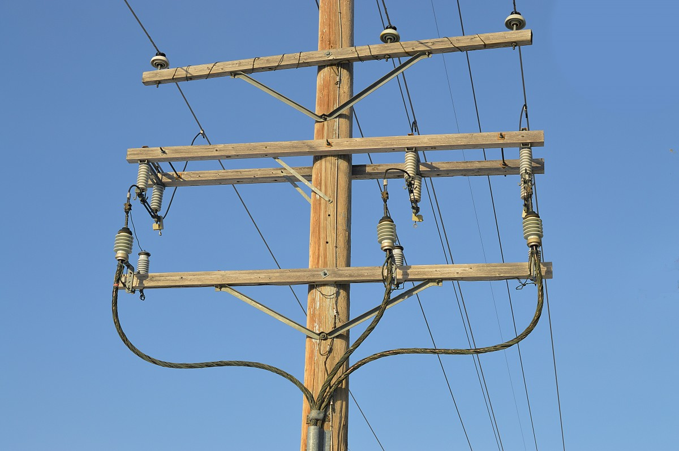
Electric Utility Enterprise Fund as of January 31, 2025 Target Budget Use-58.3%
CATEGORIES | FY 2024-25 Actual | Encumbrances | Revised Budget | CY % of Budget Used | FY 2023-24 Actual | LY % of Budget Used
Revenue
45 - REV-USE MONEY/PROP | 54,779 | - | 96,133 | 57.0% | 14,129 | 77.9%
46 - CHARGES FOR SERVICES | 15,716,028 | - | 24,311,431 | 64.6% | 13,212,351 | 56.2%
47 - RECOVERD & OTHR/DEBT | 43,500 | - | 27,500 | 158.2% | 22,617 | 180.9%
48 - INTERGOV REVENUE | - | - | - |  | - | --
49 - TRANS FROM OTHR FUND | 156,659 | - | 313,317 | 50.0% | - | --
90 - BUDGETARY OFFSET ACC | - | - | - |  | - | 0.0%
Revenue Total | 15,970,965 | - | 24,748,381 | 64.5% | 13,249,097 | 54.8%
Expense
50 - SALARY AND BENEFITS | (1,411,386) | - | (2,308,804) | 61.1% | (1,083,629) | 57.6%
52 - SUPPLIES & MATERIALS | (125,838) | (12,469) | (316,950) | 43.6% | (219,710) | 71.2%
53 - PROF. SERVICES | (7,762) | - | (82,850) | 9.4% | (43,059) | 23.4%
54 - CONTRACTUAL & OTHER | (425,649) | (8,020) | (1,639,196) | 26.7% | (679,552) | 48.8%
55 - UTILITIES | (7,114,966) | (17,481) | (18,708,179) | 38.1% | (7,440,894) | 42.4%
56 - OTHER EXP/ FIN. USES | (14,001) | - | (58,250) | 24.0% | (30,782) | 53.3%
57 - DEBT SERVICES | (407,605) | - | (407,604) | 100.0% | (385,212) | 100.0%
58 - CAPITAL OUTLAYS | - | (278,391) | - |  | - | 0.0%
59 - TRANS TO OTHR FUNDS | - | - | - |  | - | --
90 - BUDGETARY OFFSET ACC | - | - | - |  | - | 0.0%
Expense Total | (9,507,208) | (316,361) | (23,521,833) | 41.8% | (9,882,838) | 40.9%
Excess Rev. Over (Under) Exp. | 6,463,757 | (316,361) | 1,226,548 | 500.9% | 3,366,260

Slide 9

Water & Sewer Utility Enterprise Fund as of January 31, 2025 Target Budget Use-58.3%
CATEGORIES | FY 2024-25 Actual | Encumbrances | Revised Budget | CY % of Budget Used | FY 2023-24 Actual | LY Actual % of Budget Used
Revenue
45 - REV-USE MONEY/PROP | 132,729 | - | 217,512 | 61.0% | 120,542 | 58.4%
46 - CHARGES FOR SERVICES | 5,748,409 | - | 9,291,560 | 61.9% | 5,174,365 | 58.9%
47 - RECOVERD & OTHR/DEBT | - | - | - |  | 9,336 | 933.6%
48 - INTERGOV REVENUE | - | - | - |  | - | #DIV/0!
49 - TRANS FROM OTHR FUND | - | - | - |  | - | #DIV/0!
90 - BUDGETARY OFFSET ACC | - | - | 314,817 | 0.0% | - | 0.0%
Revenue Total | 5,881,138 | - | 9,823,889 | 59.9% | 5,304,242 | 44.4%
Expense
50 - SALARY AND BENEFITS | (1,720,922) | - | (3,073,059) | 56.0% | (1,605,225) | 53.4%
52 - SUPPLIES & MATERIALS | (651,658) | (2,455) | (772,600) | 84.7% | (533,565) | 50.3%
53 - PROF. SERVICES | (402,134) | - | (135,000) | 297.9% | (139,471) | 107.3%
54 - CONTRACTUAL & OTHER | (361,901) | (79,471) | (799,132) | 55.8% | (1,214,552) | 77.2%
55 - UTILITIES | (690,770) | - | (1,200,710) | 57.5% | (573,111) | 47.7%
56 - OTHER EXP/ FIN. USES | (19,522) | - | (25,975) | 75.2% | (12,747) | 49.9%
57 - DEBT SERVICES | (266,975) | - | - |  | (625,702) | 63.6%
58 - CAPITAL OUTLAYS | (396,893) | - | - |  | (1,786,350) | 48.1%
59 - TRANS TO OTHR FUNDS | (1,694,762) | - | (3,489,524) | 48.6% | (125,000) | 50.0%
60 - PILOT & ADMIN FEES | - | - | (426,889) | 0.0% | - | --
90 - BUDGETARY OFFSET ACC | - | - | - |  | - | --
Expense Total | (6,205,538) | (81,926) | (9,922,889) | 63.4% | (6,615,722) | 55.4%
Excess Rev. Over (Under) Exp. | (324,400) | (81,926) | (99,000) | 414.9% | (1,311,480)
This Photo by Unknown Author is licensed under CC BY

Slide 10
MiNet Enterprise Fund as of January 31, 2025 Target Budget Use-58.3%
CATEGORIES | FY 2024-25 Actual | Encumbrances | Revised Budget | CY % of Budget Used | FY 2023-24 Actual | LY % of Budget Used
Revenue
42 - FRANCHISE FEES | 991 | - | - |  | 4 | #DIV/0!
45 - REV-USE MONEY/PROP | - | - | 350 | 0.0% | 72 | 20.6%
46 - CHARGES FOR SERVICES | 918,635 | - | 2,106,741 | 43.6% | 1,069,448 | 54.5%
47 - RECOVERD & OTHR/DEBT | 28,584 | - | 32,000 | 89.3% | 19,441 | 32.4%
48 - INTERGOV REVENUE | 54,226 | - | 140,940 | 38.5% | 98,550 | --
Revenue Total | 1,002,436 | - | 2,280,031 | 44.0% | 1,187,515 | 58.7%
Expense
50 - SALARY AND BENEFITS | (573,050) | - | (822,479) | 69.7% | (337,587) | 57.1%
52 - SUPPLIES & MATERIALS | (45,051) | - | (148,400) | 30.4% | (57,258) | 38.6%
54 - CONTRACTUAL & OTHER | (163,391) | 36,906 | (419,625) | 46.4% | (228,549) | 44.2%
55 - UTILITIES | (342,478) | - | (508,400) | 67.4% | (303,832) | 59.8%
56 - OTHER EXP/ FIN. USES | (9,387) | - | (5,500) | 170.7% | (3,707) | 67.4%
58 - CAPITAL OUTLAYS | (291,579) | 1,870 | - |  | (59,120) | 38.7%
Expense Total | (1,424,936) | 38,776 | (1,904,404) | 76.6% | (990,052) | 51.5%
Excess Rev. Over (Under) Exp. | (422,500) | 38,776 | 375,627 | -121.3% | 197,462

Slide 11
Refuse Enterprise Fund as of January 31, 2025 Target Budget Use-58.3%
CATEGORIES | FY 2024-25 Actual | Encumbrances | Revised Budget | CY % of Budget Used | FY 2023-24 Actual | LY % of Budget Used
Revenue
45 - REV-USE MONEY/PROP | 109,190 | - | 179,750 | 60.7% | 129,259 | 81.3%
46 - CHARGES FOR SERVICES | 1,205,376 | - | 1,943,700 | 62.0% | 1,129,699 | 59.2%
47 - RECOVERD & OTHR/DEBT | 12,504 | - | 13,500 | 92.6% | 4,564 | 33.8%
Revenue Total | 1,327,070 | - | 2,136,950 | 62.1% | 1,263,522 | 60.7%
Expense
50 - SALARY AND BENEFITS | (291,501) | - | (594,721) | 49.0% | (317,074) | 49.6%
52 - SUPPLIES & MATERIALS | (61,113) | 0 | (104,050) | 58.7% | (50,829) | 47.3%
53 - PROF. SERVICES | (46,248) | - | (85,000) | 54.4% | (47,029) | 44.8%
54 - CONTRACTUAL & OTHER | (414,510) | - | (853,892) | 49.0% | (462,210) | 48.6%
55 - UTILITIES | (18,248) | - | (30,655) | 59.5% | (16,449) | 53.7%
56 - OTHER EXP/ FIN. USES | (2,469) | - | (2,469) | 100.0% | (2,469) | 100.0%
57 - DEBT SERVICES | (52,356) | - | (52,357) | 100.0% | (52,580) | 100.0%
58 - CAPITAL OUTLAYS | - | - | - |  | (372,643) | 79.3%
Expense Total | (886,444) | - | (1,723,144) | 51.7% | (1,321,282) | 56.0%
Excess Rev. Over (Under) Exp. | 440,626 | - | 413,806 | 105.6% | (57,759)

Slide 12

Questions & Comments

